Slide 1
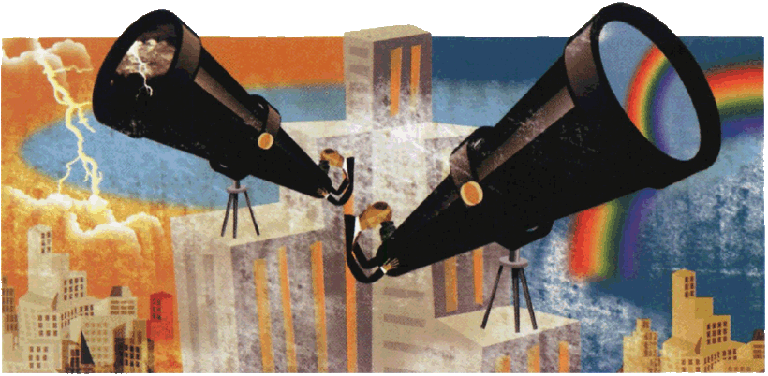

RuBase - Rebuilding and Leveraging a Knowledge Base on Russia’s International Thinking and Actingr
Stephan De Spiegeleire
HCSS Principal Scientist
Center for Non-Proliferation, Middlebury Institute ofr International Studies at Monterey, Monterey, November 19, 2018

Slide 2

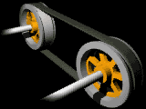

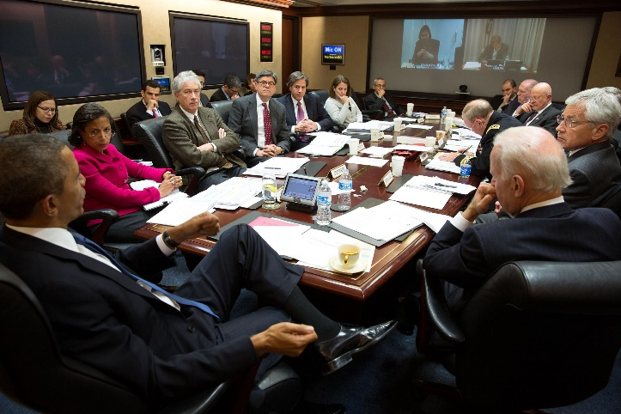
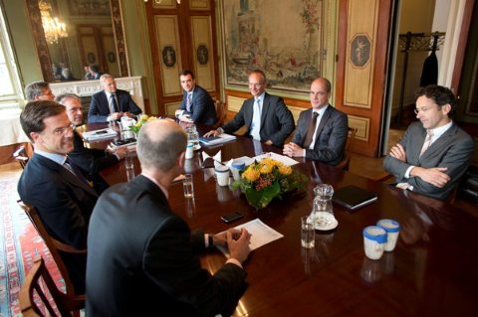
Bridging the Gap
Policy analysis
Knowledge
management
contextual analysis (what’s happening)
impact analysis (what does it mean for us?)
foresight (what might/will happen?)
policy analysis (what can we do?)
evaluation (how do/did we do?) - incl. value 4 money
capability portfolio (what do we need?)

Slide 3

Capability life cycle
Security Environment
Interests
‘Strategic Culture’
Policy
Frame/ Design
Specify
Engineer
Acquire
Manage
Employ
Adjust
Dispose
Control
Threat perception
Reduce
Political system
Values

Slide 4
Contested ‘Narratives’
Russian Assertiveness
Hybdrid Warfare
“Escalate to De-Escalate”

Slide 5
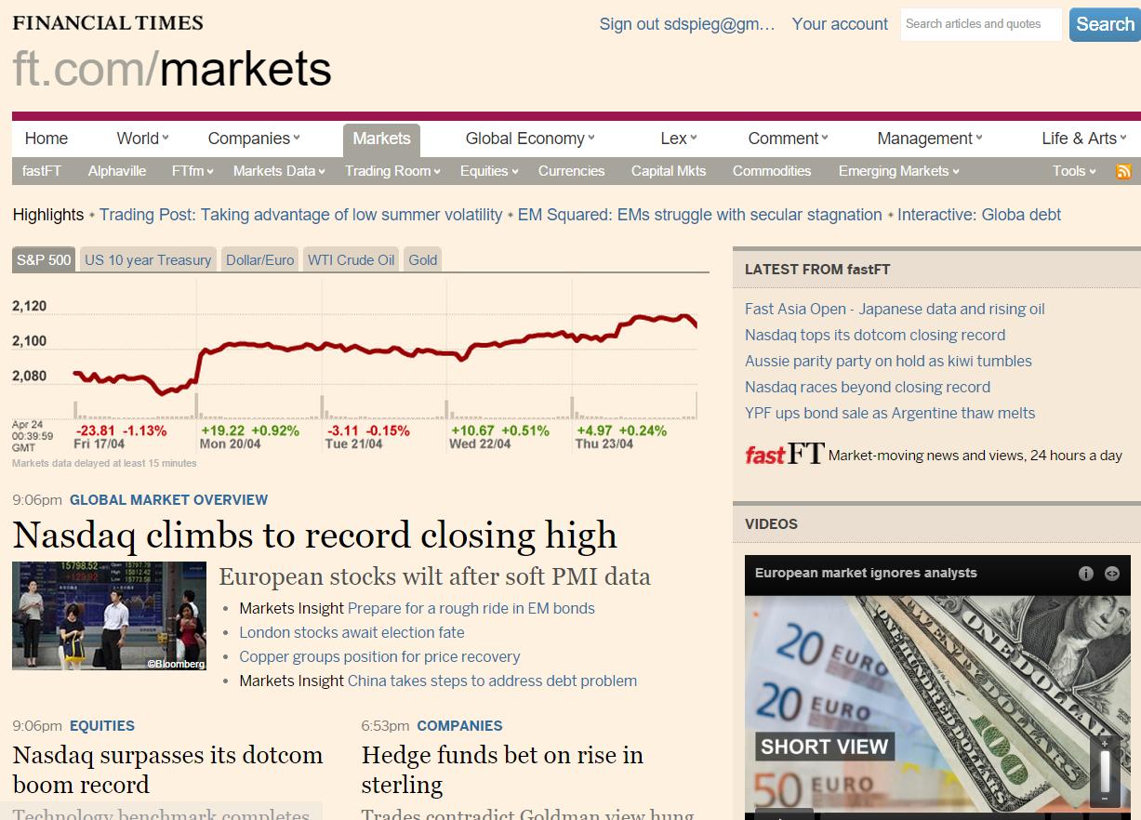
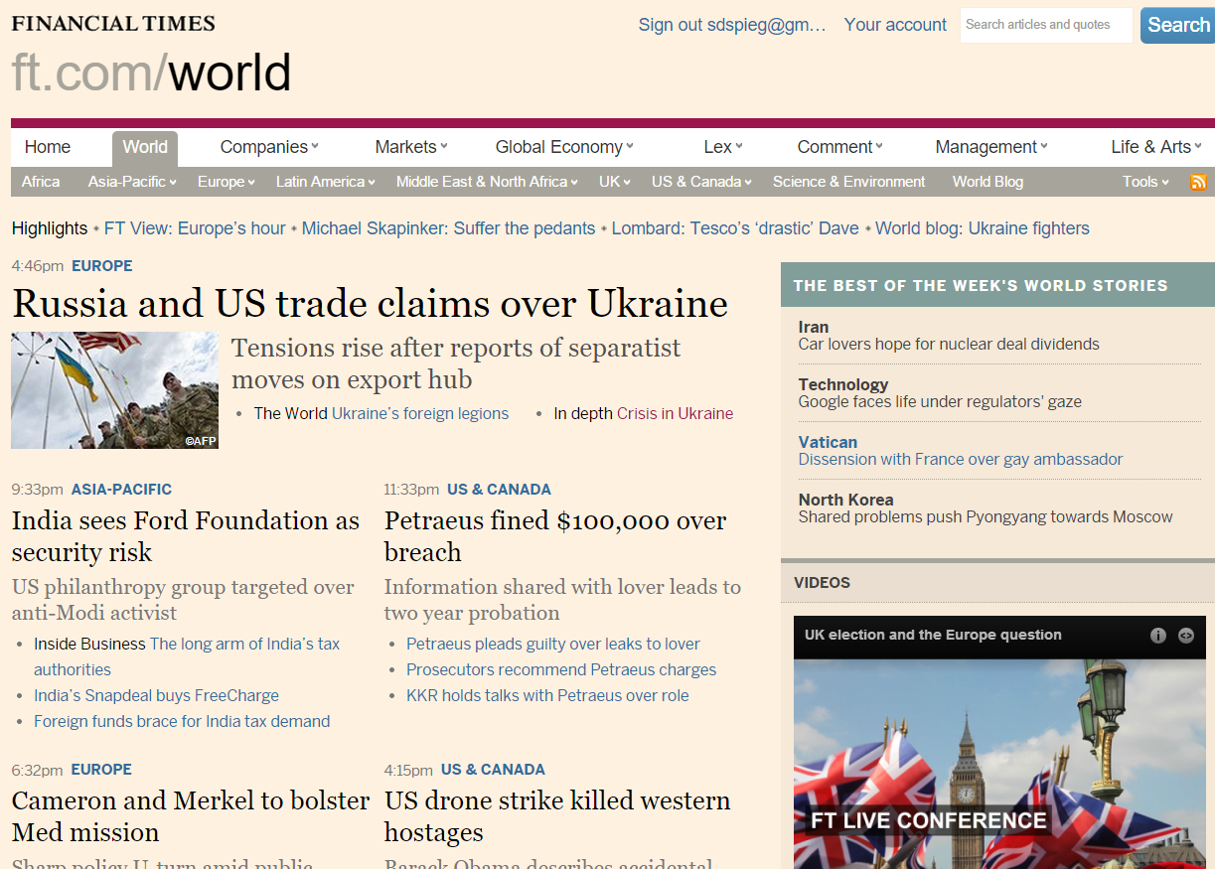
Coverage of economy vs foreign and security policy

Slide 6
From Data to Decisions
DECISIONS
change. movement
What action?
reveals directions
given purpose,
becomes
INSIGHTS
applied, integrated, actionable
What is best?
reveals principles
given insight,
becomes
KNOWLEDGE
contextual. synthesized, learning
Why?
reveals patterns
given meaning,
becomes
INFORMATION
useful, organized, structured
What?
reveals relationships
given context,
becomes
DATA
signals, know nothing

Slide 7

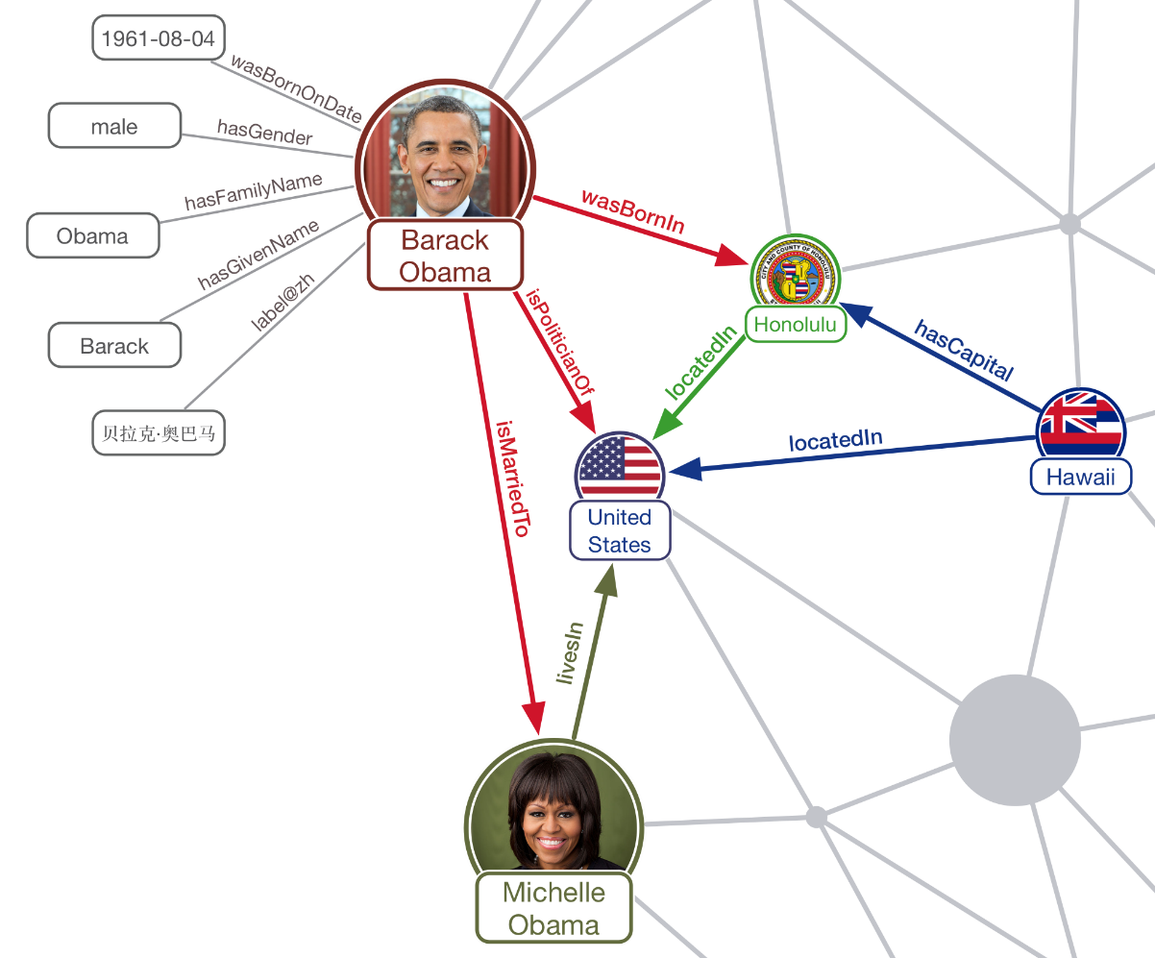
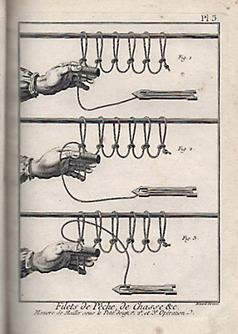
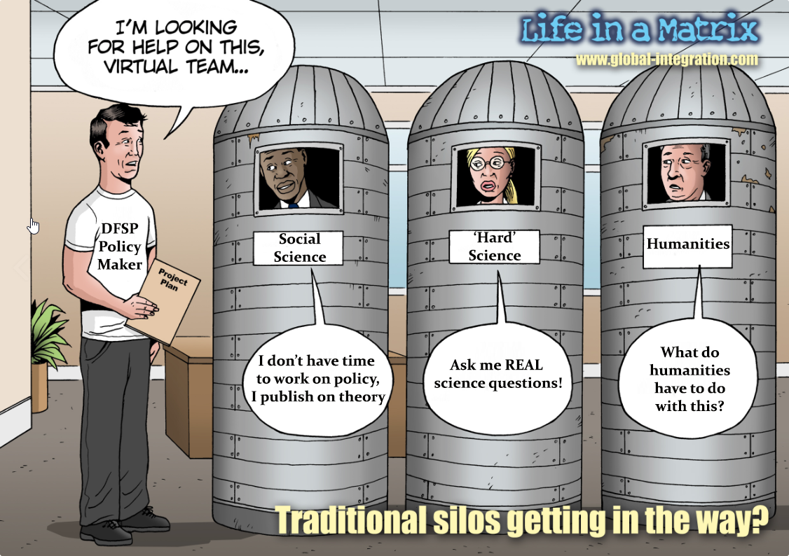
What Academia Was Supposed to Be about…
Wissensanhäufung
Cumulative knowledge building
Stovepiped knowledge
Knowledge Graph
Notes:
Enlightenment French philosopher (Denis) Diderot & mathematician (Jean Lerond) d’Alembert – ‘building knowledge’ (read title)
Then building academia – stovepiped

Slide 8
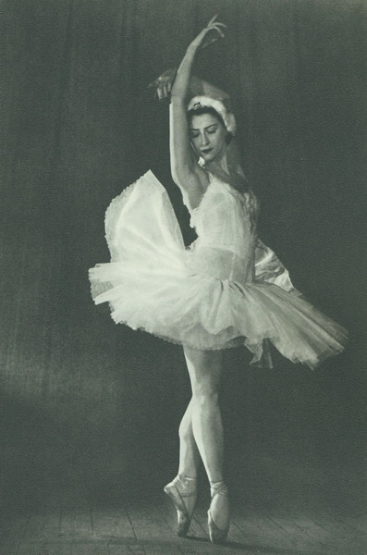
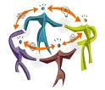

Towards Strategic Analysis 3.0
Analysis 1.0
Analysis 2.0
Analysis 3.0
Prima Donna
Connecting people /
Networks of (remarkable) people
Connecting visions
Notes:
Maya Plisetskaya, prima ballerina assoluta

Slide 9
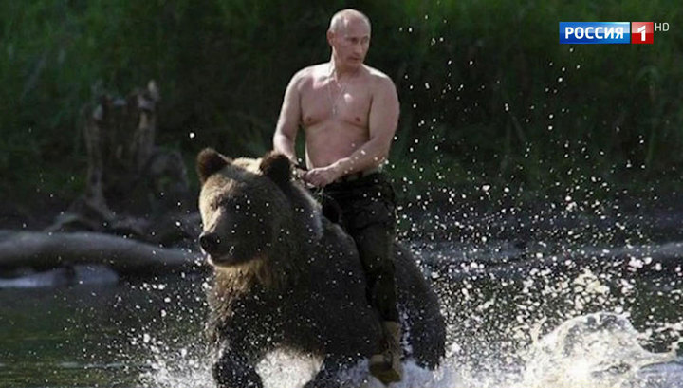
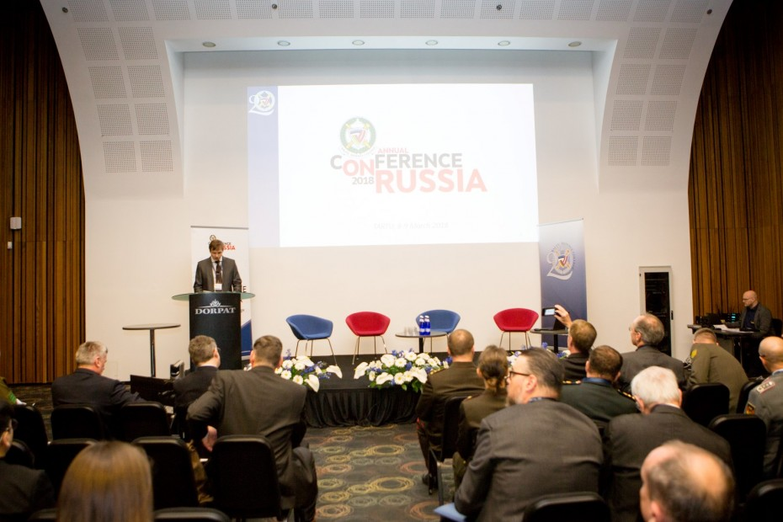
Russia is ‘Back’, We(stern Russia-Specialists) Are Not…
It’s not just pounding your fists and making loud statements, I believe that strength has several dimensions: First, a person must be convinced of the truth in what he is doing, and secondly: he must be ready to go all the way to achieve the goals that he set.

Slide 10

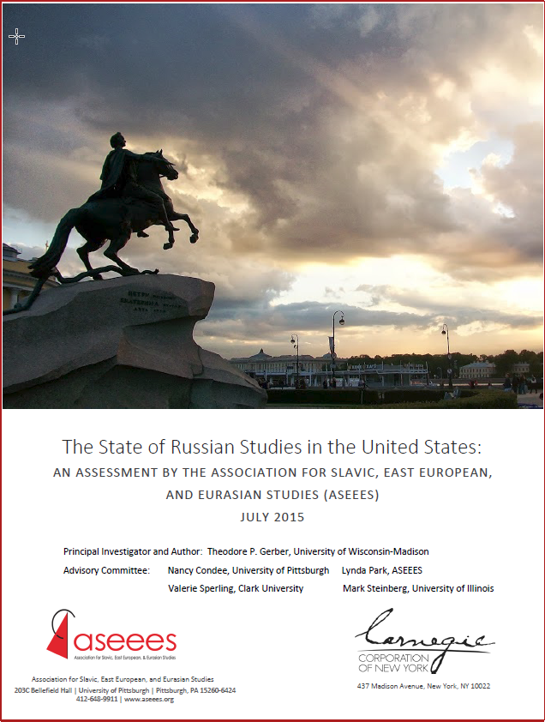
Knowledge and Policy Gaps on Soviet/Russia
Impressive cold war legacy (Enterman)
  built by USG and philanthropic (from scratch)
  closely connected to policy
  multi-dimensional
  BUT with the ‘social technologies’ of the day (training, co-location, exchanges, etc.)
End of the Cold War → constriction & diffusion of field
Today: Renewed but Skewed and Less-Focused Attention
  Low and narrow level of knowledge in policymaking & society
  Cold War inertia, blaming, false choices & limited policy tool kits
  Decline in #s and funding in field (Gerber)
  Fragmented - by disciplines, between ‘academic’ vs. applied, geographically
  Contested first order questions, referents, potential biases
  Little incentive for cumulative (policy-focused) knowledge building
  Empirics remain (unacceptably) weak - data is there, barely being used
  Unprecedented new opportunities
Notes:
Integrate w/ key finds from AAASS report—AS to change prose…puts some other points here (and tone down)
Decline in interest and numbers of grad students vs. rise interest/training data analytics (MA) & professional opportunities (pub & private sector);
Healthy reliance on current news/gov’t reports; ;Rus lang reports vs. in c reliance on interviews 65% by social sci.– Soc Sci esp open mix of methods
survey data but not integrated
Low level of knowledge of Russia– esp in gov’t– lang– but across Society; travel;
Reliance heuristic short-cuts- monpolithic decmaking;Putin factor or even small Kremlin faction matters for all security related issue and unstructured analogies- Cold War?
Contested frames/assumptions regarding first order questions about ultimate objectives, behavior, and success of RFP: Russia rising vs. falling; punch above vs. below weight? Level of aggression outstrips US, PRC; hybrid warfare; escal to descal? Rus has semeblance of coherence strategy (direct vs. indirect competition; opportunistic, raiding; asym– but how measure)?Rus eastern pivot or not? Hoas it weathered crisis and well situated to naviage long-term confrontation? (Kofman) On DP side– IS russia Fascist– as Marlene– what is referrent; trends; Russian power in IR (up, down or flatline-AKuchins vs. Simon- quant indic; qual; temporal context; right indicatory/qual= tech innov vs. multi dim/asymmetric dim/dynamic interaction (next step)
Lack real comparatve perspective; out in context.
Same re Russia mesaging– presents policy options deliberated in US as binary- enage or not; engagers too weak– that feeds binary choises in US decisionmaking- false choice btnw engage vs. confront (fuels partisanship in fp); sanction or do nothing
Impedi to knowledge generation stymie create use of policy toolkits-- esp beyond mil dimension and sanctions. Disconnect btwn resort to sanctions and assessment of effectiveness. – no clear critera for understanding how effort towards what aims w/ Russia– result of conceptual hazimess percept that US at loss what to do; oinconsistent use of intrutments; decline cred; alter sources of leverge amid asymmetry (other non-kin dimensions- fina, econ, energy, info)– how understand US leverge/influence vs. Russia- foseize opport for const ngagement re lever where Rus weakness and have most impact- how assess when ready to acy when opport knoks (requires understand who key stakeholders are on issue area; what intersts and zone of influ (who to target what), what they actually doing vs. rhetoric. What getting out of action– so not over-react-
Real chal of travel; vs. more diversified coverage via data analytics
SS avg 1.3 Rus collaborators
Concern about bias in field– mitigated by data?
Shortcoming in reearch- comparatve persective, CW assump; access Rus srcs ; lack reliable empirical data (esp among SS),

Slide 11



RuBase-CCNY
Carnegie Corporation of New York, which Andrew Carnegie (1835 - 1919) established in 1911 - "to promote the advancement and diffusion of knowledge and understanding,"
$3.3B endowment, spends about 5.5% per year (150M)
HCSS and GATech are the primes
$400k for 2 years (Jan 2018-Dec 2019)
Goal: to build a knowledge base/graph on Russia’s international coercion
HCSS goal - first step towards ‘RuBase Prime’, a (sustainable and actionable) knowledge platform with a knowledge ecosystem

Slide 12


RuBase general approach: spiral development
Building text corpora
Collating and joining existing datasets
Building new datasets
Building textmining tools
Building datamining tools
Textmining the text corpora
New forms of collaboration
Datamining the datasets
Findings
Findings
Interaction with SMEs
RuBase Data warehouse
Can this be made sustainable?
Exploitation
Notes:
Major point—iteration, b) do-assess—review.
May put this into the next section in

Slide 13





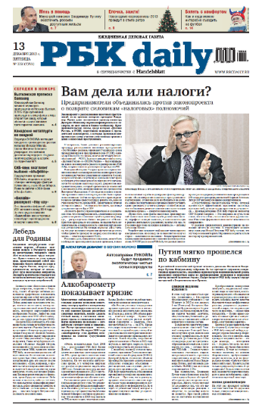
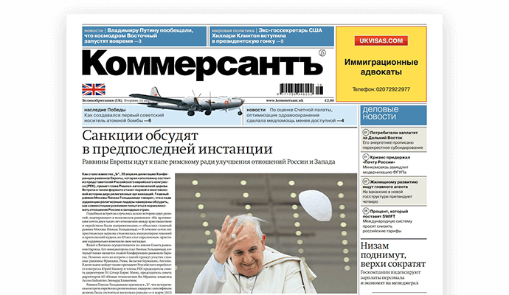
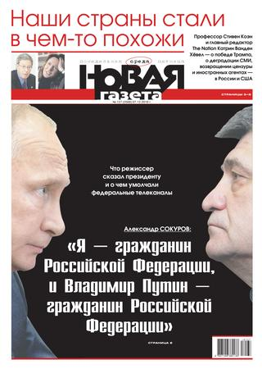


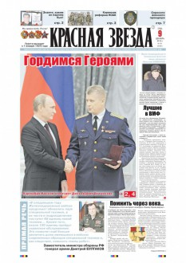

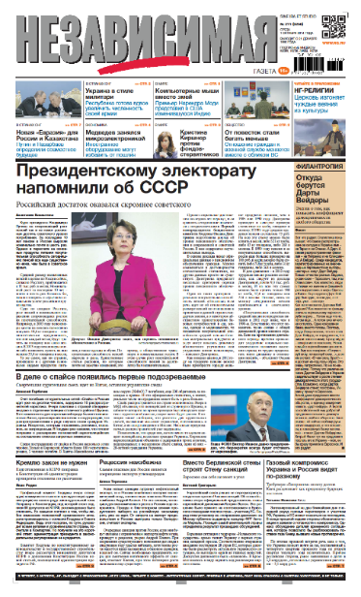
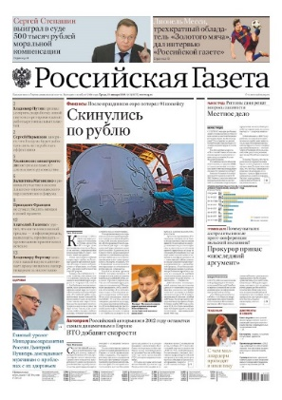



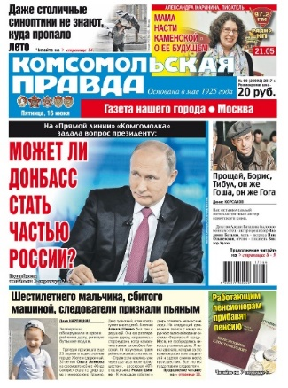





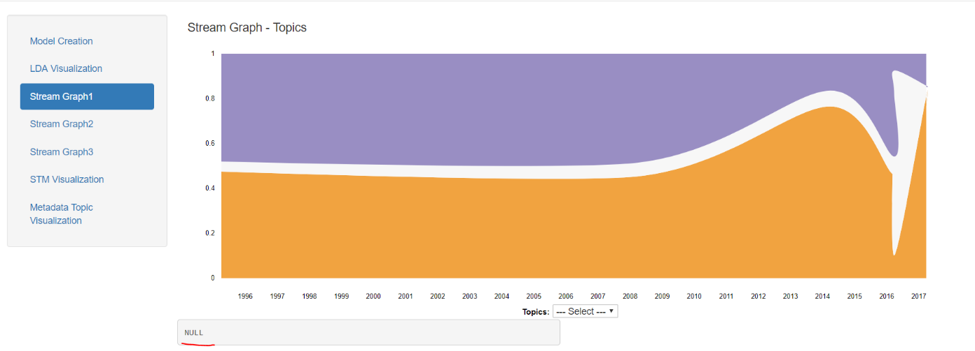
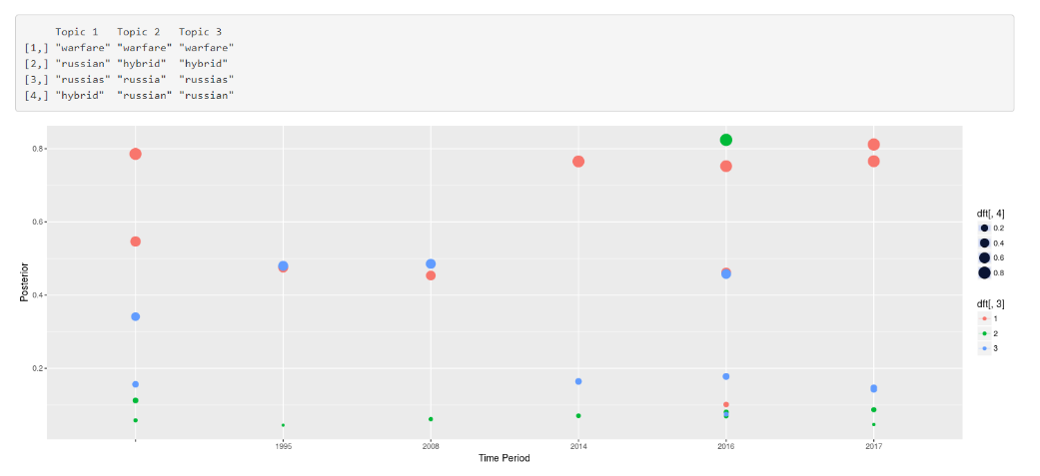

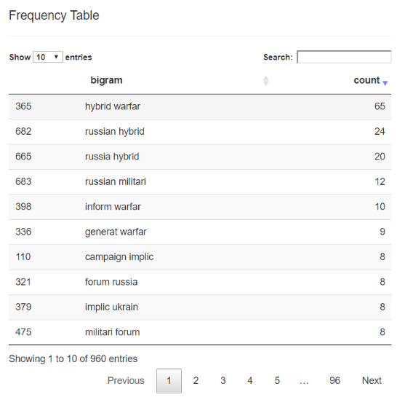
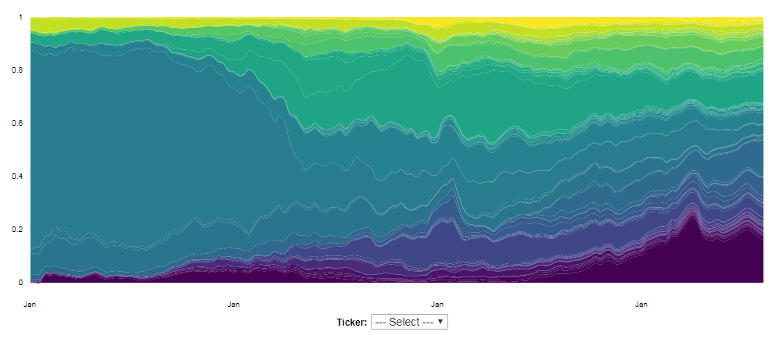


Text
Sources
Search query algorithm
Actor basket
Coercion basket
International basket
Corpora
about 11 mil articles
‘Gold standard’ cases + machine learning

Slide 14






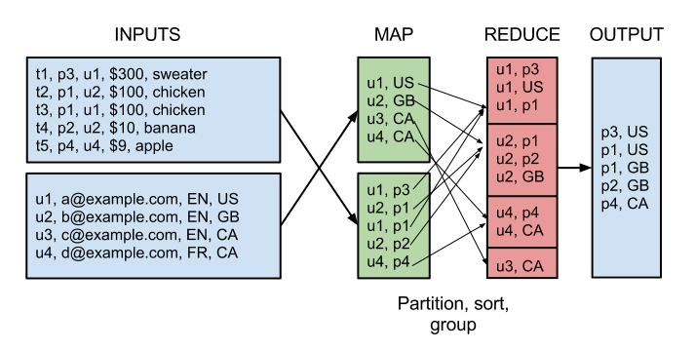








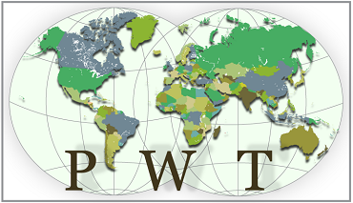



Data
11,014 variables, all joined-up in our RuBase data warehouse
General
RuBase-specific
Survey of Russian Elites,
1993-2016

Slide 15
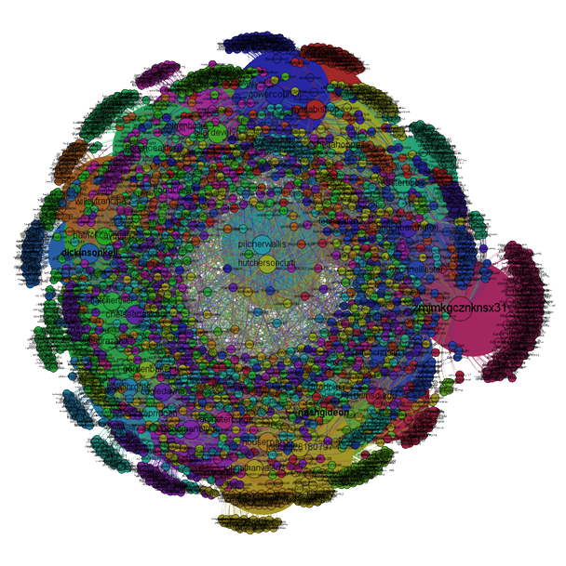
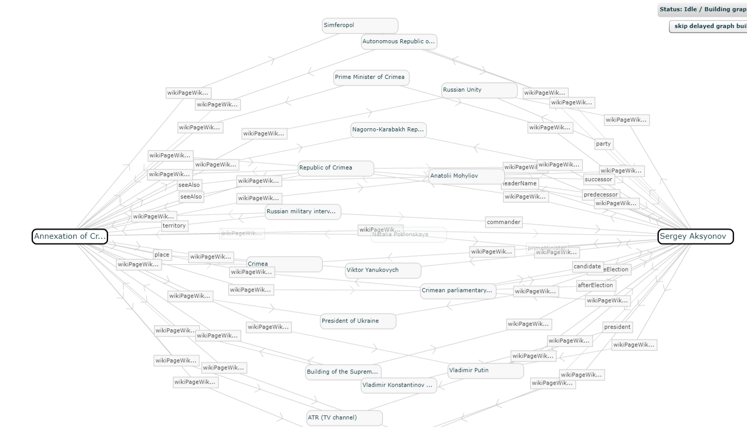





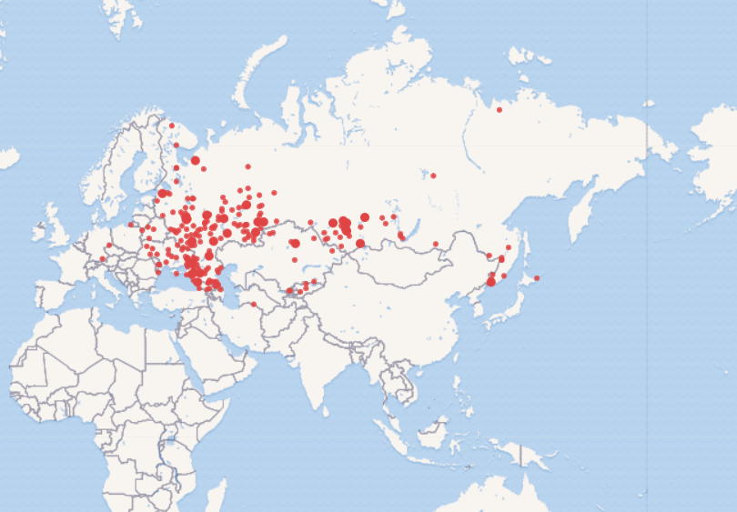




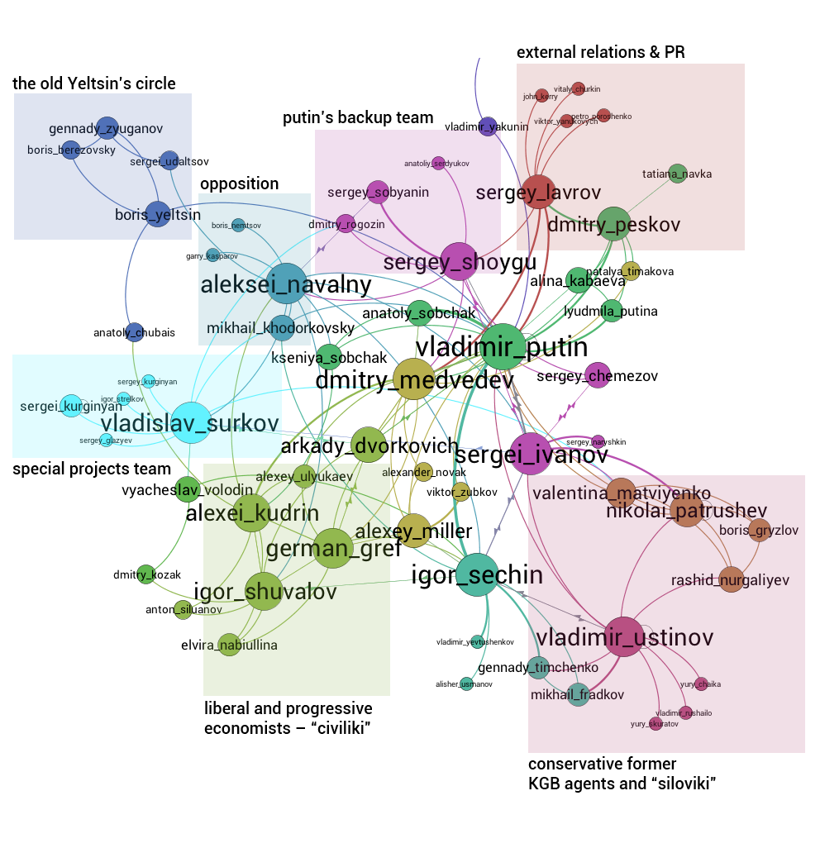


Knowledge graphs
queries
Sources: Official websites of the services (logos); map of relations between Sergei Aksyonov and the annexation of Crimea (created by RuBase team in RelFinder) ; map of GosDuma deputies’ birthplaces (created by RuBase team in Wikidata query service), map of Twitter bot accounts (+ their friends and followers) – Lawrence Alexander

Slide 16
Text - Examples: Rules-Based
Automated Event Datasets

Slide 17
Text - Examples: Event datasets
Sources
Scraper
MongoDB
CoreNLP
scraper_
connection.py
Geocoder
PETRARCH2
Formatted event records
formatter.py
JSON
Verb
dictionaries
Actor
dictionaries
Full event data
Duplicates/Unique
Server
onadayformater.py
phox_uploader.py
Notes:
mongo_connection.py - Function that creates the dictionary of content to add to a MongoDB instance, checks whether a given URL is already in the database, and inserts the new content into the database.

Slide 18
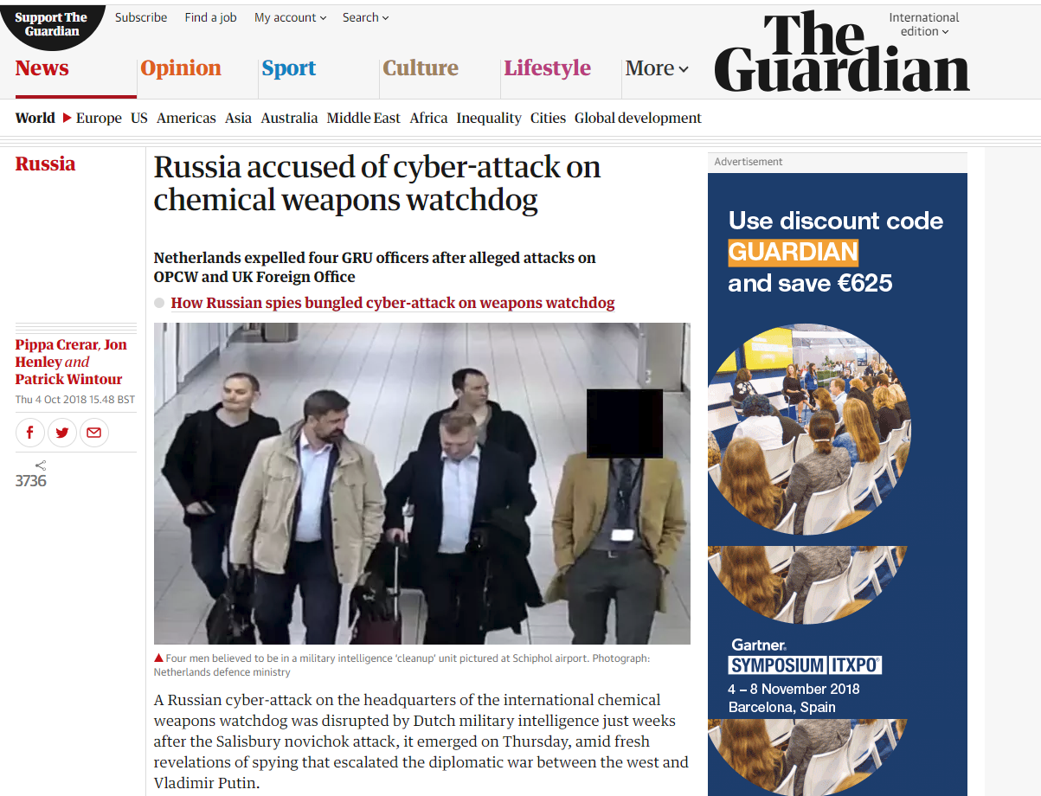
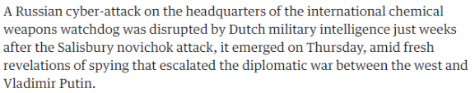
An example
Coding result:
Source actor: ‘Dutch Military Intelligence’ -> actor code NLDMILSPY
Event: ‘disrupted’ -> event code 160 (reduce relations- disrupt)
Target actor: ‘Russian (cyberattack)’ -> actor code RUS

Slide 19

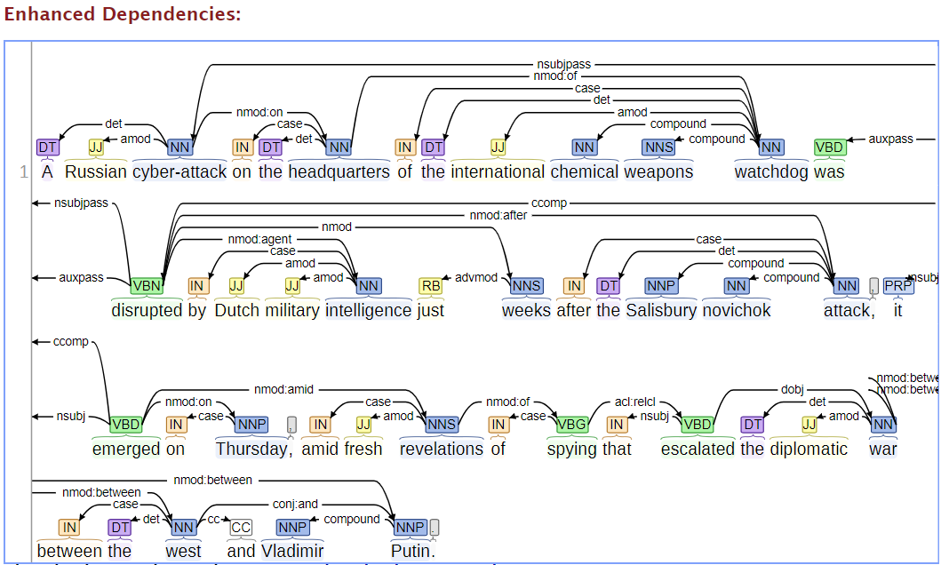
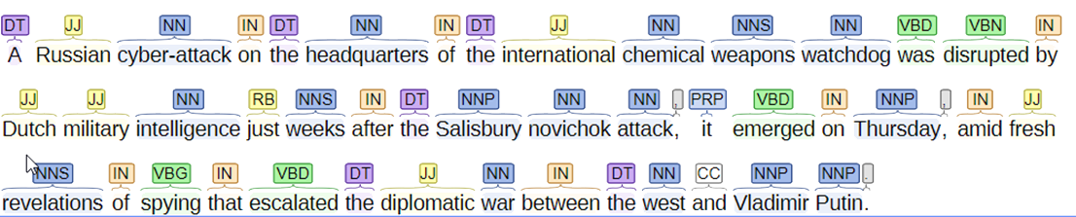
Natural Language Processing
Looking for triples - who does what to whom?
Target-actor
Determiner
Noun, sing
Noun, plural
Verb, past
Adjective
Preposition
Verb, past participle
Adverb
Personal pronoun
Event
Source-actor

Slide 20
Cameo codes
Root CAMEO | Description | Quad Class | Quad Class Description
1 | Make Public Statement | 0 | Neutral
2 | Appeal | 0 | Neutral
3 | Express Intent to Cooperate | 1 | Verbal Cooperation
4 | Consult | 1 | Verbal Cooperation
5 | Engage in Diplomatic Cooperation | 1 | Verbal Cooperation
6 | Engage in Material Cooperation | 2 | Material Cooperation
7 | Provide Aid | 2 | Material Cooperation
8 | Yield | 2 | Material Cooperation
9 | Investigate | 3 | Verbal Conflict
10 | Demand | 3 | Verbal Conflict
11 | Disapprove | 3 | Verbal Conflict
12 | Reject | 3 | Verbal Conflict
13 | Threaten | 3 | Verbal Conflict
14 | Protest | 4 | Material Conflict
15 | Exhibit Force Posture | 4 | Material Conflict
16 | Reduce Relations | 3 | Verbal Conflict
17 | Coerce | 4 | Material Conflict
18 | Assault | 4 | Material Conflict
19 | Fight | 4 | Material Conflict
20 | Use Unconventional Mass Violence | 4 | Material Conflict
20 top-level codes + 200 subcodes (‘disrupt’ is 160)
--- DISRUPT [160] ---
 | DISRUPT
 | DISARRAY
 | DISORDER
 | - * &AIRCRAFT OVERSHOT RUNWAY [---] # DISRUPT <ab 31 Dec 2005>
 | - STUDENT * SPEECH BY + [140] # DISRUPT <sls 01 Mar 2008>

Slide 21
Cameo subcodes - ’16’ = ‘reduce relations’
160 | Reduce relations, not specified below
161 | Reduce or break diplomatic relations
162 | Reduce or stop aid, not specified below
1621 | Reduce or stop economic assistance
1622 | Reduce or stop military assistance
1623 | Reduce or stop humanitarian assistance
163 | Impose embargo, boycott, or sanctions
164 | Halt negotiations
165 | Halt mediation
166 | Expel or withdraw, not specified below
1661 | Expel or withdraw peacekeepers
1662 | Expel or withdraw inspectors, observers
1663 | Expel or withdraw aid agencies

Slide 22
The Netherlands in the actors codes
NETHERLANDS_ [NLD]
+DUTCH_
+DUTCHMAN_
+HOLLAND_
+HOLLANDER_
+NETHERLANDER_
+DUTCHWOMAN_
+NEATHERLANDS_
+DUTCH_INHABITANTS_
+NEHTERLANDS_
+PAYS_BAS_
+OLANDA_
+HOLLANDA_
+THE_NETHERALANDS_
+THE_NETHERLAND_
+AMSTERDAM_
+ROTTERDAM_
+GRAVENHAGE_
+THE_HAGUE_
+APELDOORN_
+ARNHEM_
+DEN_HAAG_
+EINDHOVEN_
+NIJMEGEN_
+LEIDEN_
+LEYDEN_
+UTRECHT_
+FRIESLAND_
+HOOK_OF_HOLLAND_
+HOEK_VAN_HOLLAND_
+IJSSEL_
+IJSSEL_RIVER_
+IJSSELMEER_
JOOP_DEN_UYL_ # CountryInfo.txt
[NLDELI 370101-730511]
[NLDGOV 730511-771219]
[NLDELI 771219-870101]
ANDREAS_VAN_AGT_ # CountryInfo.txt
[NLDELI 490101-771219]
[NLDGOV 771219-821104]
[NLDELI]
RUUD_LUBBERS_ # CountryInfo.txt
[NLDELI 570101-821104]
[NLDGOV 821104-940822]
[NLDELI]
WIM_KOK_ # CountryInfo.txt
[NLDELI 560101-940822]
[NLDGOV 940822-020722]
[NLDELI]
JAN_PETER_BALKENENDE_ # CountryInfo.txt
[NLDELI 740101-020722]
[NLDGOV 030101-101031]
[NLDGOV 020722-101114]
[NLDELI]
MARK_RUTTE_ # CountryInfo.txt
[NLDELI 550101-630724]
[NLDGOVLAB 030101-030531]
[NLDGOV 630724-650414]
[NLDGOV 030601-050131]
[NLDGOV 101101-101130]
[NLDGOVEDU 050201-070228]
[NLDGOV >110101]
[NLDELI]
AART_JAN_DE_GEUS_ # CountryInfo.txt
[NLDGOVHLH 030101-030531]
[NLDGOVLAB 030601-070228]
ABRAHAM_KLINK_ # CountryInfo.txt
[NLDGOVHLH 070601-101031]
AB_KLINK_ # CountryInfo.txt
[NLDGOVHLH 070601-101031]
[NLDGOVHLH 070301-070531]
NETHERLANDS_ANTILLES_ [NLDANT]
+NETHERLANDS_ANTILLEAN_
+DUTCH_WEST_INDIES_
+DUTCH_WEST_INDIA_
+NEDERLANDSE_ANTILLEN_
+NETHERLAND_ANTILLES_
+DUTCH_ANTILLES_
+NETHERLANDS_WEST_INDIES_
+NETHERLAND_ANTILLIES_
+KINGDOM_ISLANDS_
+ANTILLEN_
+NETHERLAND_WEST_INDIES_

Slide 23
Actors
Actors
MILITARY_BASE [~MIL]
MILITARY_CLIQUE [~MIL]
MILITARY_COMMISSION [~MIL]
MILITARY_DELEGATION [~MIL]
MILITARY_FORCE [~MIL]
MILITARY_GROUP [~MIL]
MILITARY_INTELLIGENCE [~MILSPY]
MILITARY_INTELLIGENCE_AGENCY [~MILSPY]
MILITARY_INTELLIGENCE_APPARATUS [~MILSPY]
MILITARY_INTELLIGENCE_SECRET_POLICE {} [~MILSPY]
MILITARY_JUDGE [~MILJUD]
MILITARY_JUSTICE [~MILJUD]
MILITARY_LED [~MIL]
MILITARY_MACHINE [~MIL]
MILITARY_OFFICER [~MIL]
ActorEntity
ActorRole
ActorAttributes
IMG | international militarized group
IGO | inter(national) governmental organizations
MNC | multinational corporations
NGO | nongovernmental organizations
GOV | Government
MIL | Military
REB | Rebel
OPP | Opposition
PTY | Political Party
COP | Police and Internal Security
JUD | Judicial Actor
SPY | Intelligence Service
MED | Media
EDU | Educational Actor
BUS | Business
CRM | Criminal
CVL | Civilian
primary sub-state identity, ethnic and religious codes, whether the actor is a societal elite, and whether rebels
are identified as insurgents or separatists,
ActorFull

Slide 24
Column names
Number | Column Name | Description
1 | EventID | Globally unique event ID & data version
2 | Date | Date in YYYYMMDD format
3 | Year | Year in 4 digit integer
4 | Month | Month in 1 or 2 digit integer
5 | Day | Day in 1 or 2 digit integer
6 | SourceActorFull | All codes for source actor
7 | SourceActorEntity | Entity code for source actor (usually country code)
8 | SourceActorRole | Primary role code for source actor
9 | SourceActorAttribute | Other attributes for source actor
10 | TargetActorFull | All codes for target actor
11 | TargetActorEntity | Entity code for target actor (usually country code)
12 | TargetActorRole | Primary role code for target actor
13 | TargetActorAttribute | Other attributes for target actor
14 | EventCode | Event code in CAMEO ontology (includes leading zeros)
15 | EventRootCode | Event code aggregated to 20 top-level CAMEO (leading zeros)
16 | PentaClass | High level score on conflict–cooperation, material–verbal
17 | GoldsteinScore | A -10 to 10 conflict-to-cooperation scale
18 | Issues | Thematic information based on keywords in the event sentence
19 | Lat | Estimated latitude of the event
20 | Lon | Estimated longitude of the event
21 | LocationName | Finest resolution location of the event
22 | StateName | State or province where the event occurred (not supported)
23 | CountryCode | Country where the event occurred (ISO 3 char)
24 | SentenceID | Story database ID, followed by the zero-indexed sentence number
25 | URLs | URL of the scraped story
26 | NewsSources | Abbreviated name of news source

Slide 25
GDELT findings: China & Russia overall
Steady rise (+50%) in assertiveness since 1980
Since 2003 seems to increase even more
Overall, less oscillation
Since 1980, upward trend
Russia more aggressive than the late-Soviet period
Yeltsin period (1991-2000) not as ‘friendly’ as is now sometimes thought (e.g. peaks in Chechnya Dec 94)
Initial Putin reign fairly stable (with some peaks), but since then again increase
Notes:
schommeling

Slide 26
Overall Russian assertiveness
… and all of this out of 1/3 of billion worldwide events, without human interference!
traditional New Years’s lull + Sochi
Asia pivot
reality sinks in
Crimean peak
Donbass peak
the 2015 story – with the click of a button

Slide 27
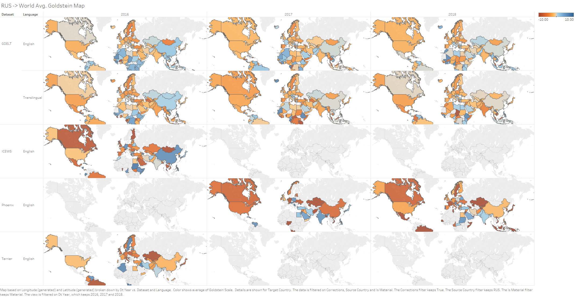
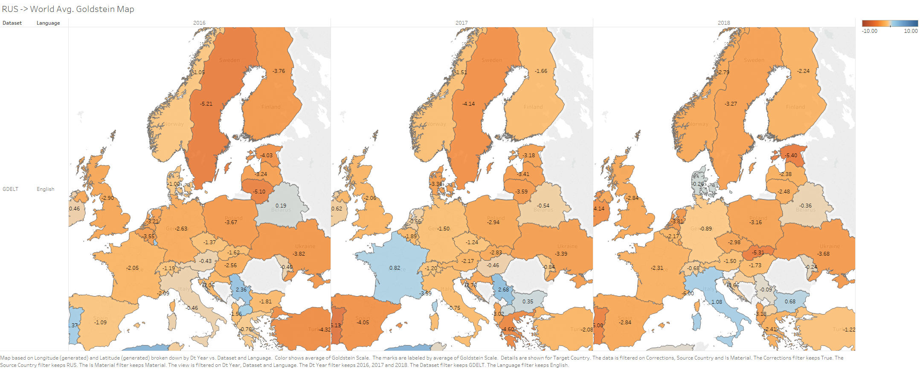
Automated event datasets

Slide 28
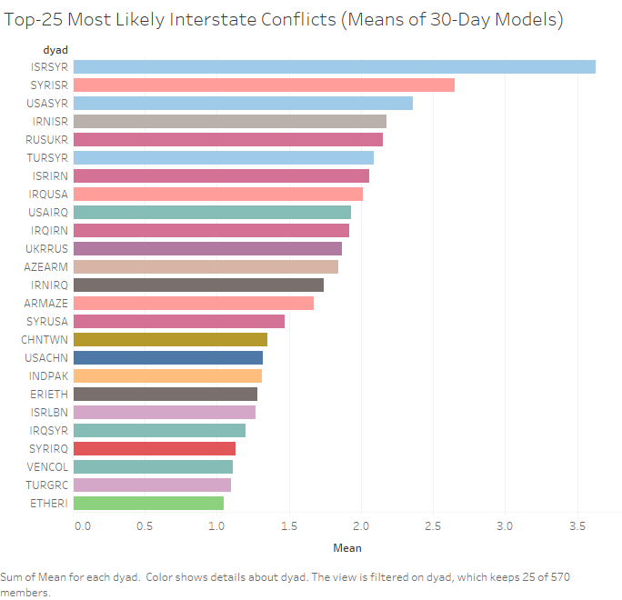
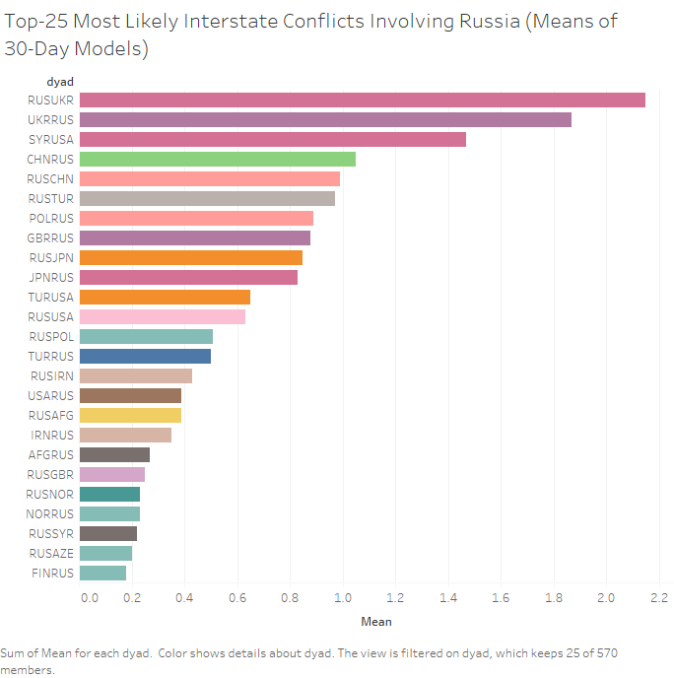
Machine Learning on Structural x Automated Event Data

Slide 29
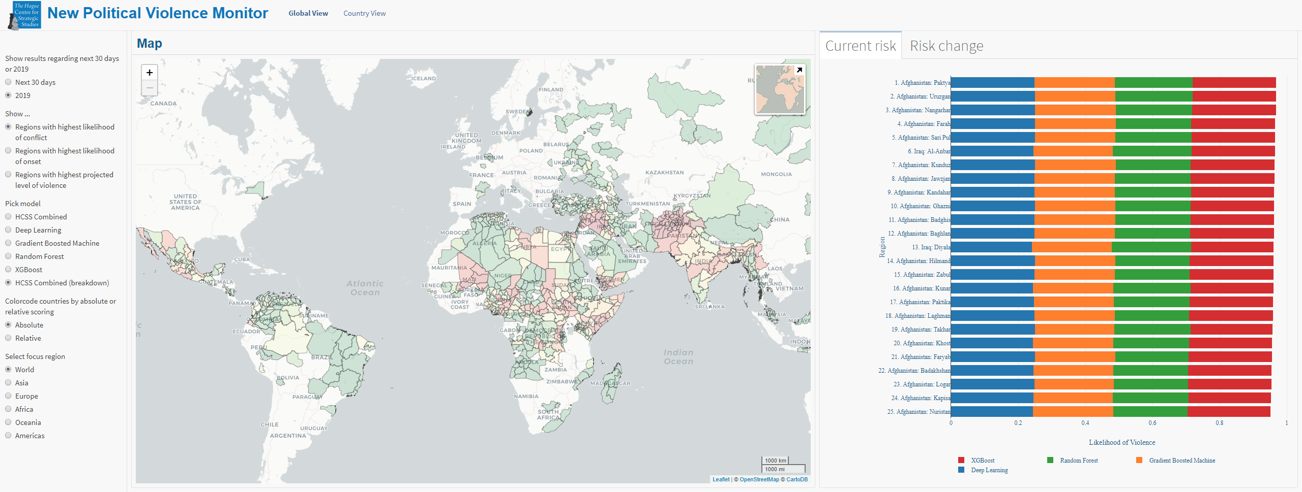
Intra-state violence risk monitor - World (2019)

Slide 30
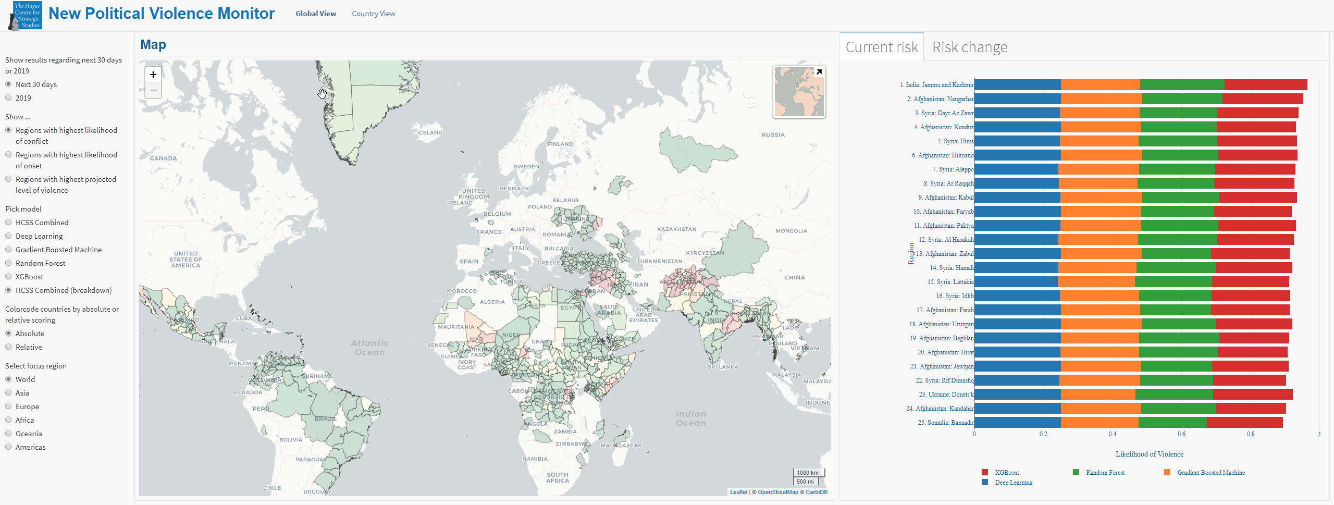
Intra-state violence risk monitor - World (next month)

Slide 31
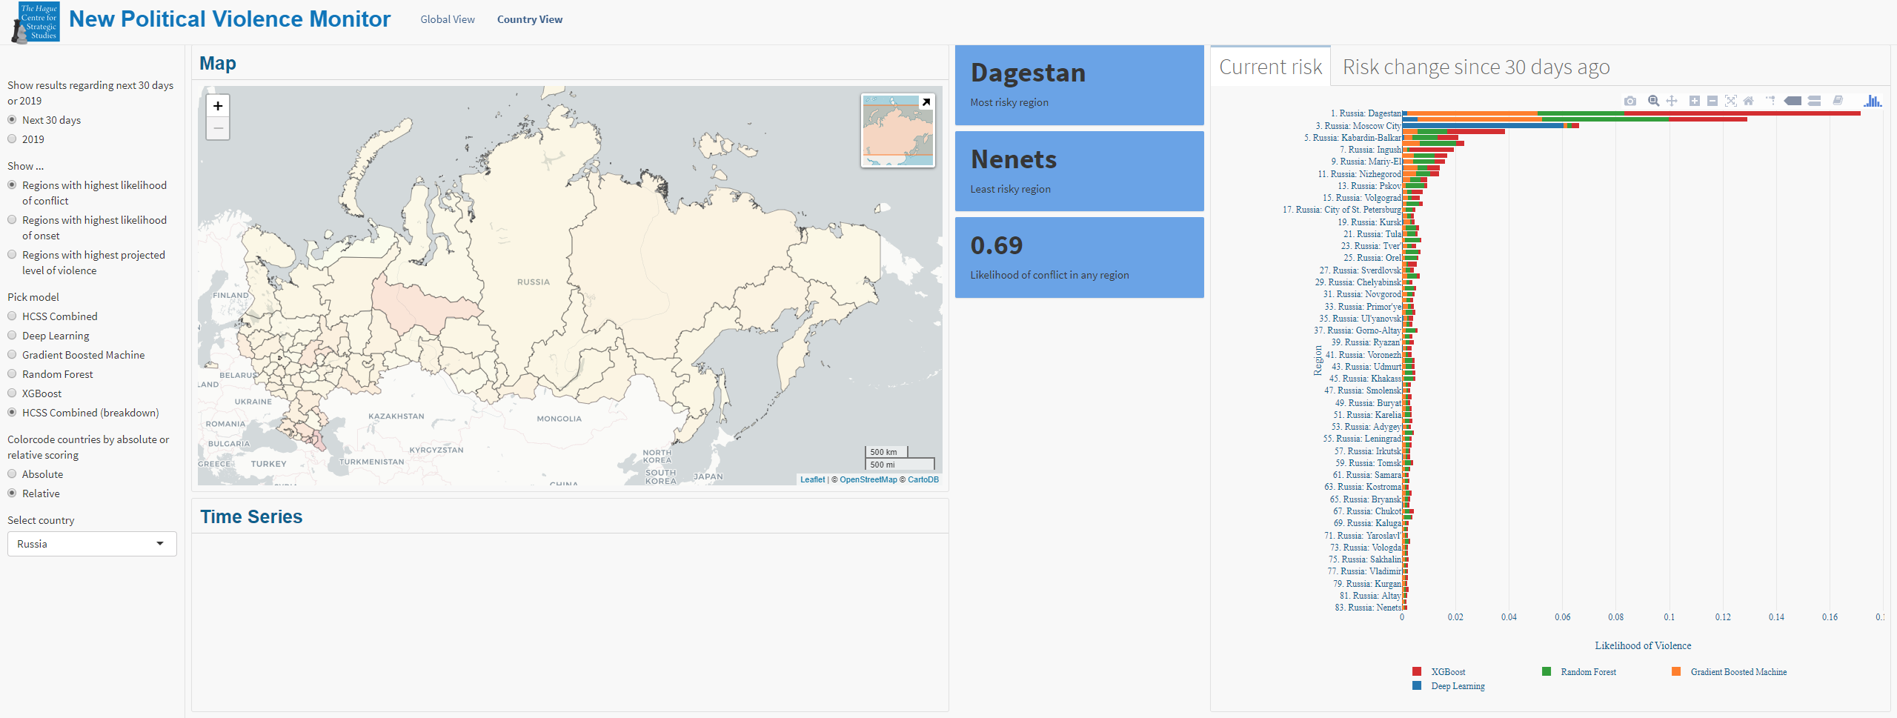
Intra-state violence risk monitor - Russia (next month)

Slide 32
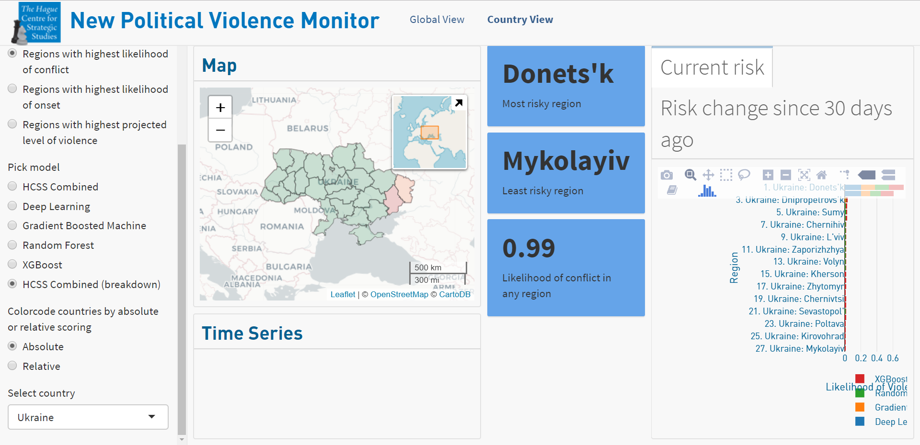
Intra-state violence risk monitor - Ukraine (next month)

Slide 33
Text - examples: machine learning (Supervised)
RuBase - Media

Slide 34

Issues with out-of-the-box GDELT
No full text
No context (information surrounding article)
Wedded to Google’s proprietary methods
Coding schemas are faulty and brittle, especially in some topics
Example rule: Russia was in breach of the armistice agreement.”
Rule: (IN BREACH) (OF LAW) [110] → Match to Cameo code 110
Code 110 is the DISAPPROVE code
Critical issue - big data can be misleading if use sloppy processing

Slide 35
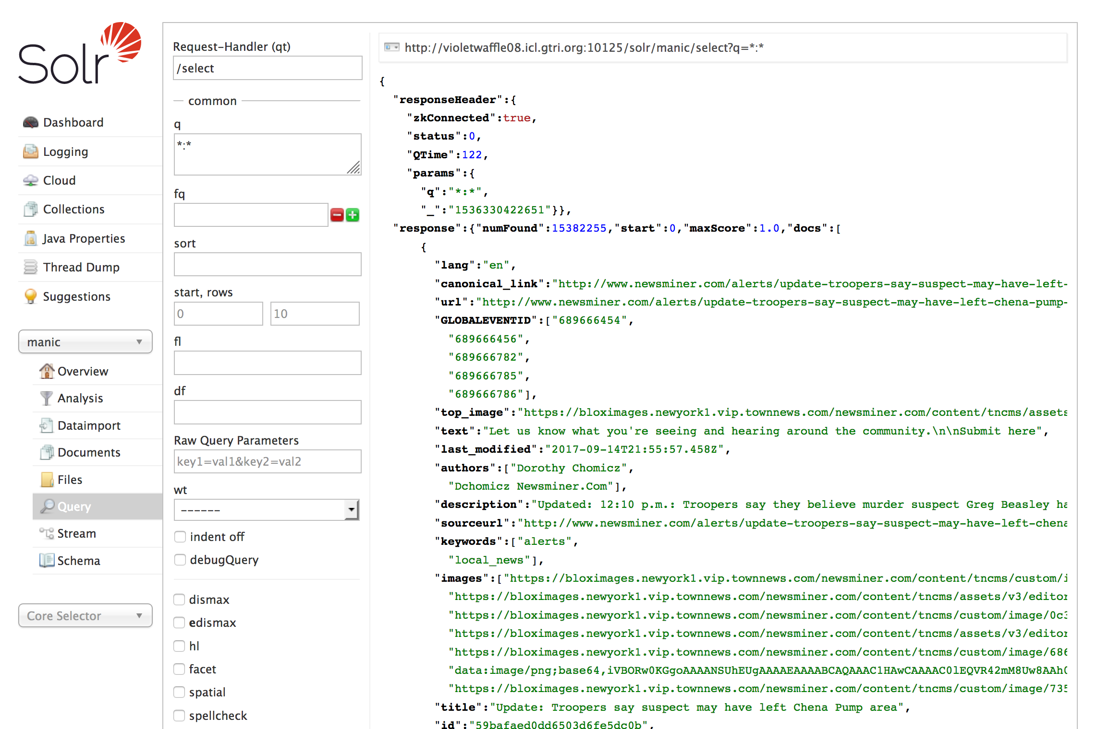
Creating, Sorting and Augmenting Haystacks
SOLR
  Multilingual search
  Relevancy ranking of results
  Deduplication
  Complex queries
SOLR RuBASE
  Time period: July 2017 – Present
  Number of full text articles: 15,363,947
  Size: 62G
  Rate: 2,000 articles per 15 min
  Latency: 5 minutes after GDELT, Real time – 20 min
Notes:
Big point—not the data being shown, but the promise of getting beyond the cameo codes to do more nuanced searches..this is one way of doing it...

Slide 36
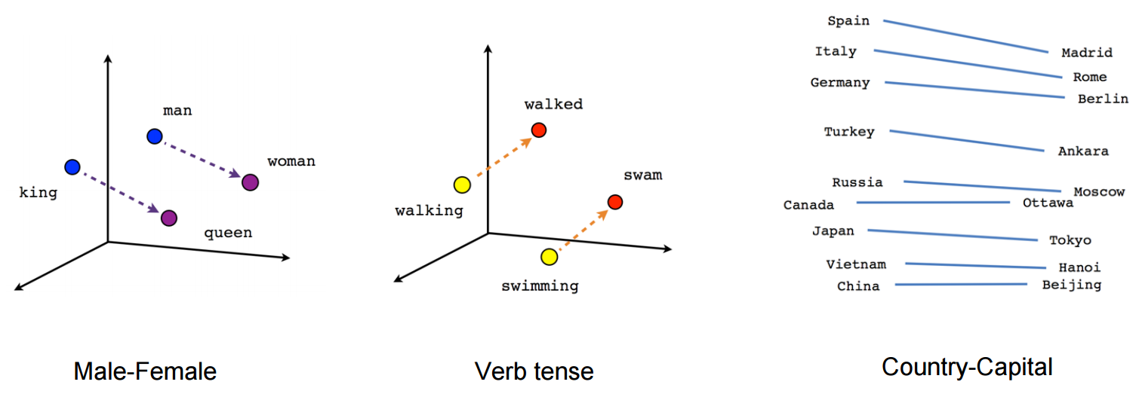
Advanced Natural Language Processing
Focus on Information Retrieval (search) and Extraction (get data)
Rules are brittle and don’t generalize well
  Example: A queen is married to a king
Vector space models are the new best in class - learn a word by the company it keeps
  Pros: Flexible & extensible
  Cons: Rare words & data hungry

Slide 37
Building NLP models for RuBase
Test standard machine learning models using word embedding based features with a tiny corpora of annotated international affairs-related research papers
Evaluate validation and test datasets to gain a cursory understanding of how potentially useful supervised machine learning approaches can be for specific classification problems
Method
  Acquire textual representations of research papers that have been paired with annotations. (1 paper was excluded as a duplicate data item)
  Apply data cleaning methods to standardize
  Build features
  Perform cross validation splitting
  Build and evaluate models
Classification
  Influence Assert from Russia
  Influence Assert to Russia
  Russian Coercion
  Russian Response
  Russian Specific Concepts
Notes:
JD note—can put into two column / boxes plus a header

Slide 38



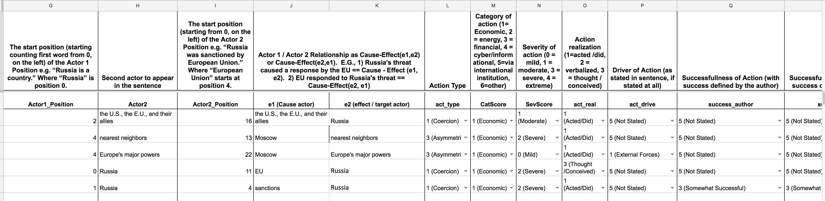
Improved Coding for Russian Coercive behavior
Coding Schema: Expert Annotation to ’Teach’ ML Algorithm
Notes:
-Redu this section..

Slide 39
Understanding (Coercive) World Events in Text
Russia responded in kind, denying the Russian market to a number of imports from the U.S., the EU, and their allies.”
Actor 1 = Russia
Actor 2 = The US, The EU, and their allies
Coercion Type = Economic
Coercion Severity = Moderate
Action Type = Acted/did

Slide 40
Patterns from Codes
1SEPT2017: Russia expels 755 US diplomats
6APR: More US Sanctions (Elites/Businesses)
26MAR2018: EU and US expel Russian diplomats
Median Normalized Frequency
30APR2018: Major protests against Russian government's decision to block Telegram
Notes:
Question—does this fit into the second presentation than in the first? If we are doing this as an EXAMPLE to illustrate the approach for data sets,
NEW COMMENT:
THIS IS REALLY HARD TO READ

Slide 41
Text - examples: machine learning (UnSupervised)
RuBase - Academic corpora

Slide 42
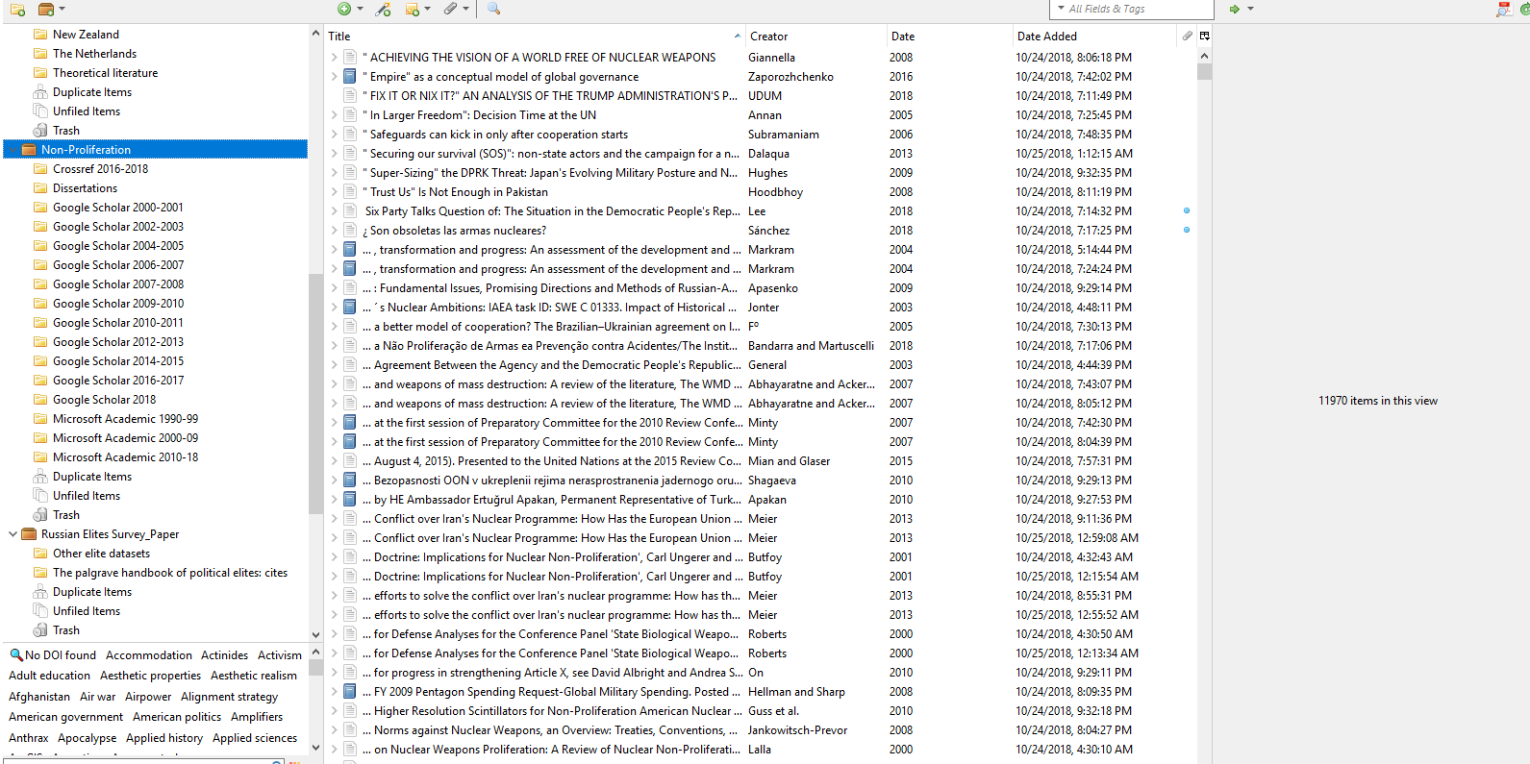

Slide 43
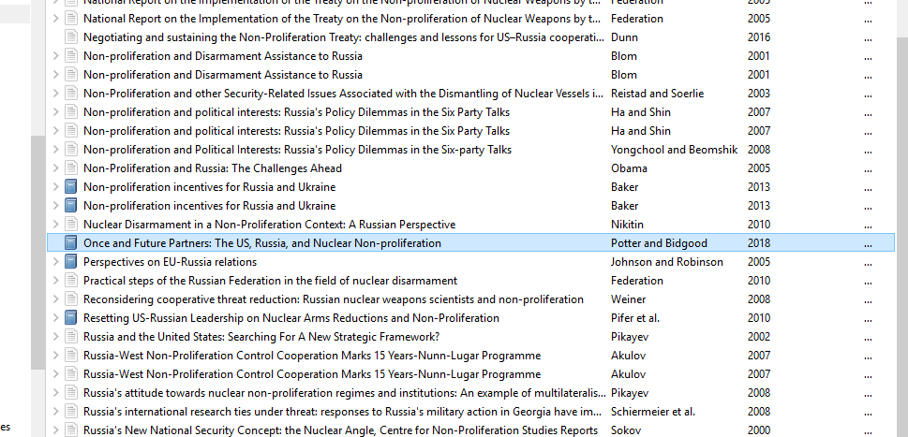

Slide 44
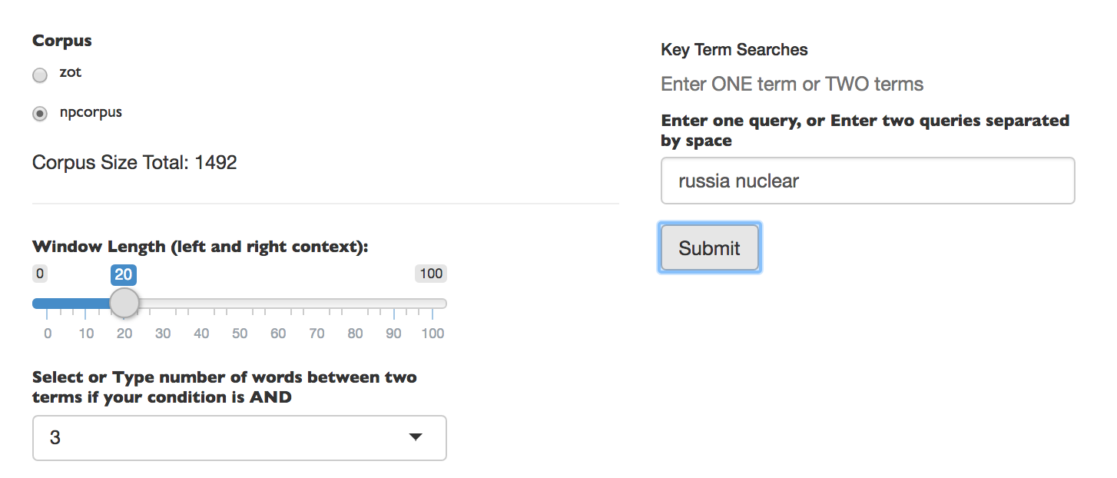

Slide 45
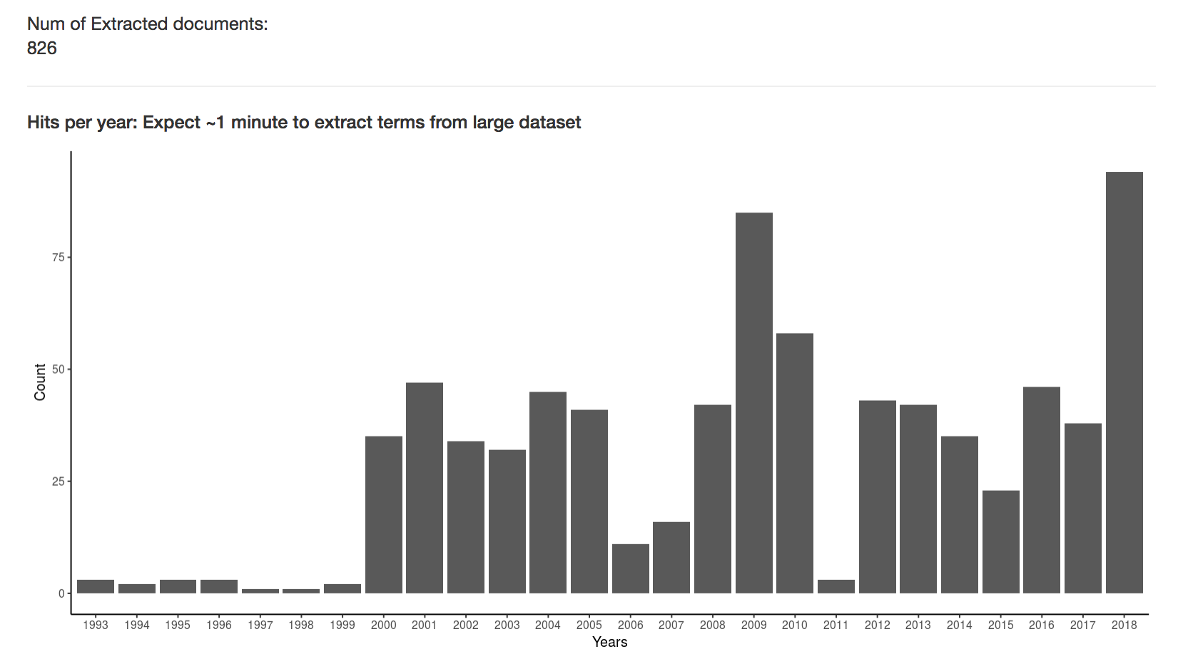

Slide 46


Slide 47


Slide 48



Slide 49


Slide 50


Slide 51



Collaboration
RuBase ecosystem
Soundboard group
Students/scholars willing to play ball
‘The core’
(including HCSS Team-Ukraine)
Source of original image: Paint your target: how to create a bullseye graph in Tableau by Gwilym Lockwood, https://www.theinformationlab.co.uk/2017/05/24/paint-target-create-bullseye-graph-tableau/

Slide 52







Where is Rizzoma’s place
Rizzoma is one of the new stars in a 'new' wave of collaborative tools that are all quite 'google'y
document-centric
documents are at the center
discussion possible but limited
project-centric
improve on old-fashioned project management ideas
very linear
discussion-centric
the most useful for knowledge workers
Easily linked to the first two categories

Slide 53

Topics window
Main window

Slide 54


Mind map
If you’re feeling lost in a big topic – you may switch to a mind map view to see a topic’s tree

