Slide 1
A Worst Practices Guide to Preventing Leaks, Attacks, Theft, and Sabotage
Matthew Bunn and Scott D. Sagan
James Martin Center for Nonproliferation Studies May 17, 2017

Slide 2
Insider Threats: New from Cornell U Press
Hegghammer & Daehli – Jihadi thinking on nuclear insiders
Zegart – Ft. Hood shooter (Nidal Hasan)
Stern & Schouten – Anthrax letters (Bruce Ivins)
Long – Green-on-blue attacks in Afghanistan
Bunn & Glynn – Insider security for casinos and pharma
Bunn & Sagan – Introduction and conclusions – “worst practices guide”
Part of American Academy of Arts and Sciences “Global Nuclear Future” initiative
http://www.cornellpress.cornell.edu/book/?gcoi=80140100868640

Slide 3
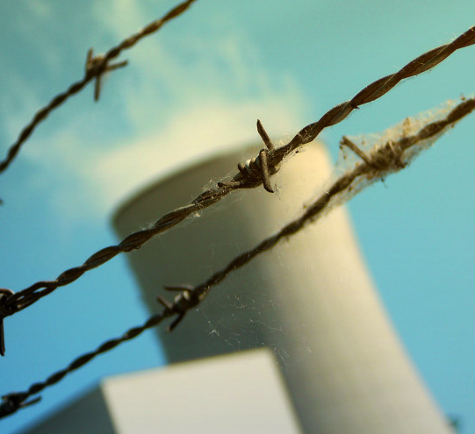
Cognitive, Organizational Biases Undermine our Ability to Cope with Insider Threats
Insiders are the most serious threat to nuclear, intelligence, and many other organizations
But insiders are trusted, authorized employees
Cognitive dissonance, affect bias, illusion of control lead people to ignore warning signs
Organizational dysfunction adds disincentives to reporting, acting on warning indicators
Even seemingly obvious “red flags” are sometimes ignored
Doel-4 nuclear power plant – sabotaged by an insider in 2014

Slide 4
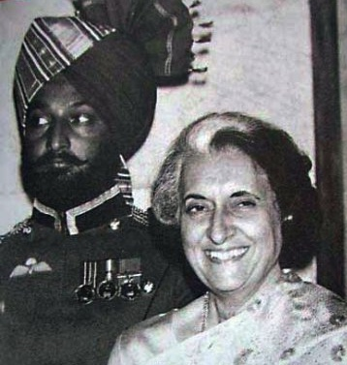
Lesson #1: Don’t Assume that Serious Insider Problems are NIMO (Not In My Organization)
Case Study I: Indira Gandhi Assassination
Death threats against Gandhi and her family after 1984 crackdown on Sikh uprising
Extra security personnel deployed to Gandhi’s residence
Gandhi protested suggestion that Sikh bodyguards should be placed only on outside perimeter of compound
Gandhi assassinated by two Sikh guards on October 31, 1984
Beant Singh and Indira Gandhi

Slide 5
A special problem for Lesson #1: Rapid Radicalization
Beant Singh was a loyal guard for years – until weeks before Gandhi’s assassination
Ilyass Boughalab had passed a background check and been granted clearance for the vital areas of the Doel-4 reactor in Belgium – was reportedly radicalized in months after the check was over, left to fight for terrorists
Numan Haider – Australian teenager, radicalized in months
Numan Haider’s Facebook page

Slide 6
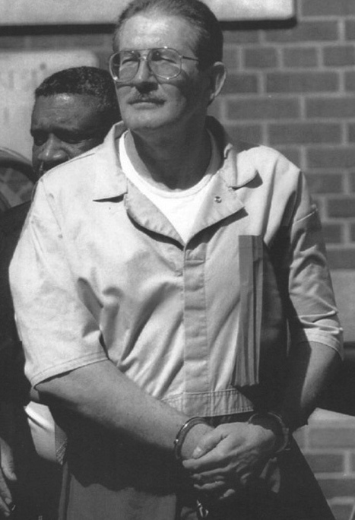
Lesson #2: Don’t Assume That Background Checks Will Solve The Insider Problem Case Studies: Aldrich Ames, Leonid Smirnov, and Northern Bank Theft
Background checks are not perfect
Aldrich Ames passed lie detector tests
Leonid Smirnov was considered a trusted employee
Loyal employees can be coerced
2004 Northern Bank theft
People may be radicalized after they pass a check – and quickly
Aldrich Ames

Slide 7
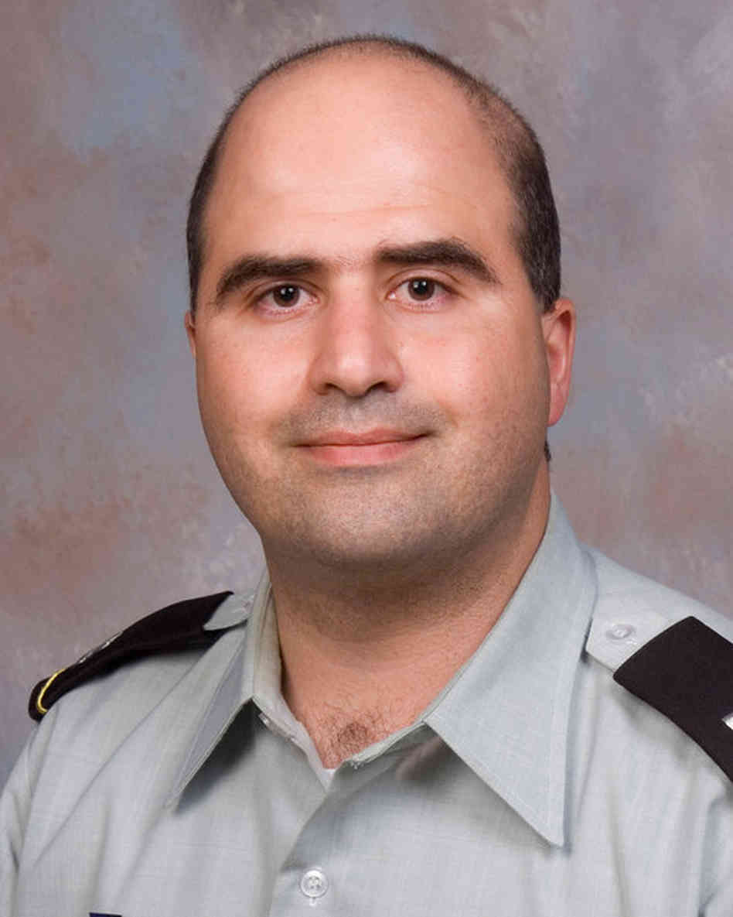
Lesson #3: Don’t Assume That Red Flags Will Be Read Properly Case Study I: 2009 Fort Hood Shooting
Hasan voiced radical beliefs and emailed Anwar al-Awlaki – a known terrorist
Reasons for failure to act
Army system for reviewing officers’ performance failed to forward relevant information
Social shirking + the Army’s needs
Colleagues feared being accused of bias
Intelligence officer interpreted al-Awlaki emails as “research”
Misunderstanding on who was following up investigative leads
Maj. Nidal Malik Hasan

Slide 8
Lesson #3: Don’t Assume That Red Flags Will Be Read Properly Case Study II: 2001 Anthrax Letters
Bruce Ivins offered many red flags
Therapists found him highly dangerous (records never reviewed)
He complained about his own dangerous paranoia (never reported)
Subordinates reported his bizarre behavior, and being afraid of him (no action taken)
Long-standing eccentricity “immunized” the organization to noticing concerning behavior
Text of Anthrax Letter

Slide 9
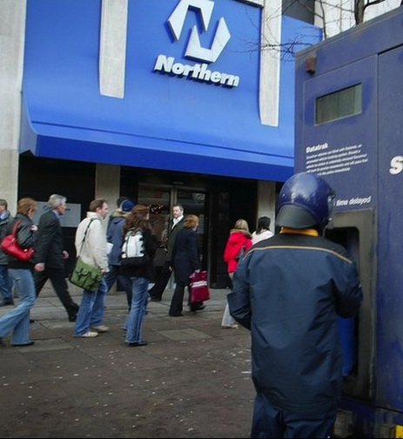
Lesson #4: Don’t Assume That Insider Conspiracies Are Impossible
Recent survey of nuclear security experts:
Single insider seen as credible, insider conspiracies generally not
Yet: insider conspiracies not unusual
More common than single insiders in Sandia study of major heists
Where practical, security systems should be designed to cope with more than one insider
Site of 2004 Northern Bank Theft

Slide 10
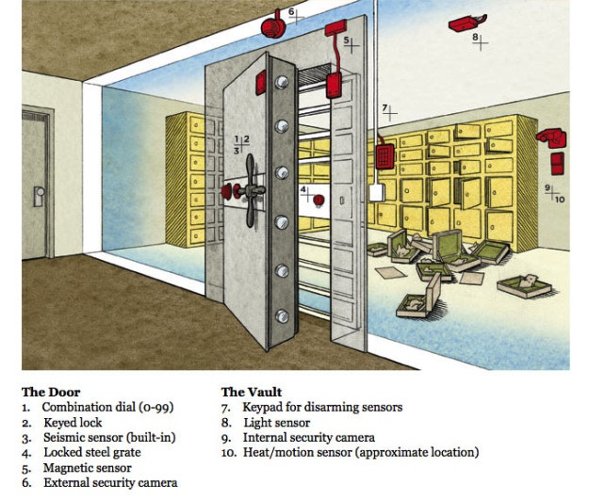
Lesson #5: Don’t Rely on Single Protection Measures
Portal monitors can be defeated or gone around
Seals can be defeated
Staff often fail to report concerning behavior
Effective security requires comprehensive, multi-layered approach
Realistic testing and creative vulnerability assessment are essential
2003 Antwerp Diamond Center Heist
Source: Wired

Slide 11
Lesson #6: Don’t Assume that Organizational Culture And Disgruntlement Don’t Matter Case Study I: Y-12 Incursion
2012: 82-year-old nun and two other protestors enter Y-12 facility
Passed through 3 alarmed fences, setting off multiple alarms – no one responded for extended period
New instrusion detection system setting off 10x as many false alarms
Cameras to allow guards to see cause of alarm had been broken for months
Major breakdown in security culture
Graffiti from Y-12 Break-In

Slide 12
Lesson #6: Don’t Assume that Organizational Culture And Disgruntlement Don’t Matter Case Study II: Chelsea Manning
Manning was a classic disgruntlement (and emotional disturbance) case
A dawning transgender identity in the “don’t ask don’t tell” military
Had to be restrained after being told she would lose her weekly day off for lateness
Began downloading 3 weeks later
Chelsea Manning

Slide 13
Lesson #6: Don’t Assume that Organizational Culture And Disgruntlement Don’t Matter Case Study III: Cyber Sabotage
One study found 92 percent of the cyber sabotage cases in the sample came after a negative work event
Over half of the perpetrators were already seen by others as disgruntled
Simple steps – listening, validating, sometimes action on complaints – can greatly reduce disgruntlement
Source: Cyber Crime News

Slide 14
Lesson #7: Don’t Forget that Insiders May Know About Security Measures and How to Work Around Them Case Study I: Robert Hanssen
Senior FBI counterintelligence agent, arrested February 2001
Convicted on 15 counts of espionage
Leaked photocopies and disks to Russia for 22 years, compromised many agents
Able to monitor internal FBI investigations, alter espionage practices to avoid detection, and avoid polygraph tests
Robert Hanssen

Slide 15
Lesson #7: Don’t Forget that Insiders May Know About Security Measures and How to Work Around Them Case Study II: Edward Snowden
Snowden was an NSA systems administrator – watching for security weaknesses was one of his tasks
The Hawaii site he arranged to be transferred to had not yet installed software to monitor unusual activity
So Snowden was able to use simple “web scraping” tools without detection
Edward Snowden

Slide 16
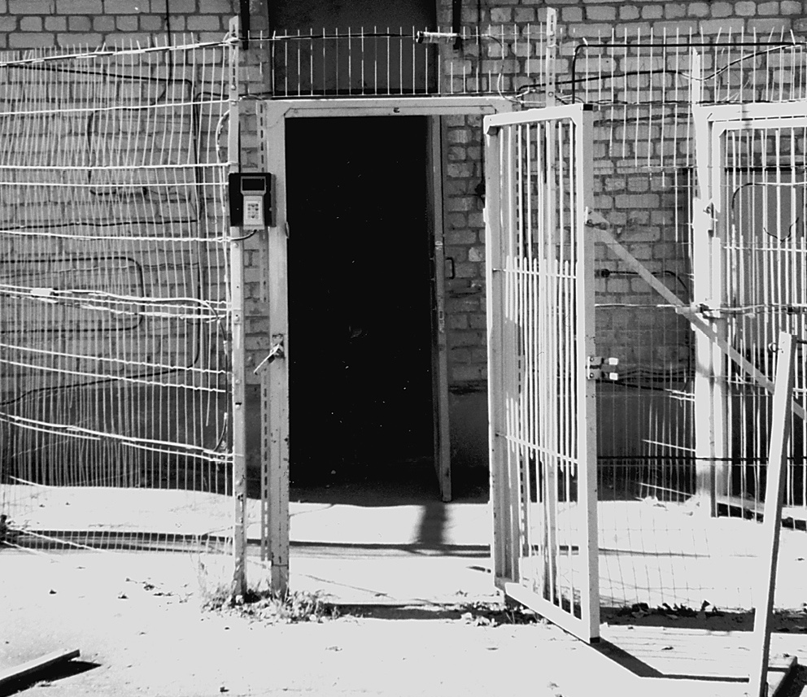
Lesson #8: Don’t Assume That Security Rules Are Followed
In both the United States and Russia, multiple cases of:
Guards patrolling without ammunition in their guns
Guards turning off intrusion detectors
Staff violating security rules for convenience
Real practice often looks much different than the practice prescribed in the rule book
Propped-open security door in Russia. Source: GAO, 2001

Slide 17
Lesson #8: Don’t Assume That Security Rules Are Followed Case Study: Wackenhut Corporation Exercises
January 2004: DOE Inspector General finds that Wackenhut Corporation had been cheating on security exercises at Y-12
Management told security guards about the plans for mock attacks
Guards planned defense and strategically placed obstacles
Best guards put on duty and number of protective personnel on shifts augmented
Guards tampered with exercise monitoring equipment

Slide 18
Lesson #9: Don’t Assume That Only Consciously Malicious Insider Actions Matter Case Study: 2015 New York Prison Break
Guard Gene Palmer developed relationship to get information from inmates
Provided tools he saw as innocent
Provided hamburger in which another insider had hidden tools
Hole next to catwalk, Clinton Correctional Facility

Slide 19
Lesson #9: Don’t Assume That Only Consciously Malicious Insider Actions Matter A key issue: Cyber
Inadvertent insiders common in cyber cases
Individuals click on a link, download a file, bring in a USB drive… and attackers get in
”Phishing” attacks are becoming more and more sophisticated, individualized
Separating networks from the internet is important – but not enough
Intentional cyber insiders are also a key issue

Slide 20
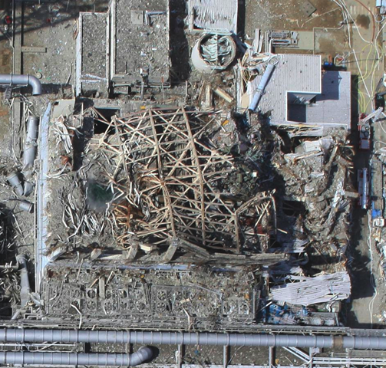
Lesson #10: Don’t Rely Only on Prevention and Assume Mitigation Doesn’t Matter
Examples:
Sabotage: safety measures and emergency response can reduce effect
Theft: Material in big and heavy forms, with low concentrations of nuclear material, immediate detection and pursuit, can reduce chance material could be used in a bomb
Source: Air Photo Service, Japan

Slide 21
Nuclear Caveat: Few Jihadist Writings or Actions on the Nuclear Insider Possibility
Hegghammer and Daehli provide new data on jihadi writings, actions
Mentions of nuclear tactics are rare
Mentions of nuclear insider possibilities are nonexistent
No known cases of jihadis actively recruiting nuclear insiders for theft or sabotage
Source: Time

Slide 22
Caveat to the Caveat: Disturbing Hints of the Potential for Nuclear Insiders
Nearly all known nuclear thefts or sabotage incidents appear to have been perpetrated by or with help from insiders
Jihadists routinely use insiders (including coerced insiders) in other contexts
Case of Ilyass Boughalab (cleared insider at Belgian nuclear plant, left to fight for terrorists) highlights potential
Source: ISIS

Slide 23
Insider threats: What should organizations do?
Build high-performance and high-vigilance culture – everyone understands that security is their job too
Build a comprehensive, multi-layered approach to reducing insider threats
Maximize the scale and complexity of challenges insider adversaries would have to overcome
Include regular assessment, testing, “red teaming” as a key part of the insider program
Design approach within the context of the laws, culture of your country and organization
Need to balance maintaining vigilance with fostering atmosphere of trust, cooperation needed for high performance

Slide 24
Insider threats: What should organizations do? (II)
A comprehensive approach should include:
Thorough background checks before access
Ongoing monitoring of behavior
Requirements, incentives to report concerning behavior, potential vulnerabilities
Effective training – with real stories
Minimizing human access to vital areas, materials, information
Continuously monitoring, controlling, and accounting for vital areas, materials, information
Effective investigations, responses to reports – seen as fair and reasonable by staff

Slide 25
A Worst Practices Guide to Preventing Leaks, Attacks, Theft, and Sabotage
http://www.belfercenter.org/publication/insider-threats

Slide 26
BACKUP SLIDES

Slide 27
For Discussion
Are there other lessons we’ve missed?
What are the most effective steps organizations can take to protect against insider threats?
How can organizations:
Counter complacency
Build strong security cultures
Ensure that red flags will be reported, acted on
Candidly and realistically assess vulnerabilities
Find a balance between watching for insiders and building trust and cooperation in the organization
What are the most important costs and risks of too much (or misdirected) focus on possible insiders?

Slide 28
Lesson #1: Don’t Assume that Serious Insider Problems are NIMO (Not In My Organization)
Case Study II: Edward Snowden
Able to download vast numbers of highly sensitive files – because insiders were not being closely monitored
Clapper: “Our whole system is based on personal trust.”
Booz Allen Hamilton CEO: “Our most trusted colleagues and friends have this in common. We can count on them… Booz Allen Hamilton is trusted in that way.”
Edward Snowden

Slide 29
Working paper from the American Academy of Arts and Sciences
10 lessons learned from case studies of insider threats in different industries, contexts
Widely used in training in U.S. facilities
Available on-line
https://www.amacad.org/multimedia/pdfs/publications/researchpapersmonographs/insiderThreats.pdf

Slide 30
Social Shirking
Protection relies on co-workers to report suspicions
Social Shirking Phenomenon
“Political Correctness” can inhibit reporting
Kitty Genovese, 1964

Slide 31
Lesson #6: Don’t Assume That Organizational Culture And Employee Disgruntlement Don’t Matter
Study of 150 insider threat incidents that occurred between 1996 and 2002
57% of insiders perceived in the organization to be disgruntled
92% of all the insiders attacked following a negative work-related event such as termination, a dispute with a current or former employer, demotion, or transfer

